Slide 1
For Case Management
(707) 304-7150 express@rate-fast.com

Slide 2
What is RateFast Express?
RateFast Express is an impairment rating tool used to quickly prepare accurate impairment rating reports for the doctor to review and sign.

Slide 3
How Does RateFast Express Help Your Doctors?
Simplifies the impairment rating process.
Maintain compliance with state regulations.
Revenue opportunity for the provider.
Creates reports based on the doctor’s own findings:
Patient history
Exam
Medical opinions

Slide 4
How do I Authorize RateFast Express?
Notify the insurance adjuster that:
The injury has reached MMI.
The doctor has elected to use RateFast Express.
RateFast Express minimizes claim costs.
Request authorization for the RateFast Express service using the RateFast Express cover sheet.

Slide 5
What Makes RateFast Express Competitive?
Reporting costs savings reduced by 40%.
Report delivery 12 times faster.
$12,600 saved in settlement costs.
Minimized risk of litigation.

Slide 6
When is My Case Ready for RateFast Express?
The Rule of 6 Months.
When all treatments have been performed and no further recovery is expected, the claim has likely reached MMI and is ready for impairment rating.
You can easily determine MMI using the RateFast MMI Calculator: http://www.ratefastmmi.com

Slide 7
How to Submit a Case to RateFast Express

Slide 8
RateFast Express Workflow
Go to www.genexratefast.com for all RateFast Express resources and instructions.
The link to RateFast Express can be found under Resources in Unity.
The entire RateFast Express workflow usually takes less than 15 minutes.

Slide 9
Step 1. Gather Documentation
After the doctor agrees to use RateFast Express, gather medical records for each body part that is ready for a rating:
The doctor’s first report.
The most recent visit note.
Any reports on surgery or consult visits.
Most recent imaging and testing reports.
Typically no more than 15 pages of records.

Slide 10
Step 2. Obtain Authorization
Complete the cover sheet, which includes:
Authorization form
Cover sheet
Introduction to RateFast Express
RateFast W9 form
Use the Price Calculator to determine the price of the impairment rating.
Send to the adjuster for approval.

Slide 11
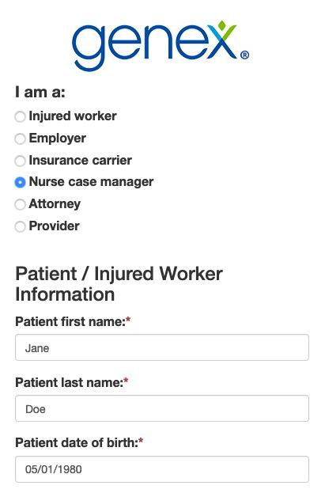
Step 3. Enter Patient into RateFast
Go to your Genex Injury Launch page https://rate-fast.com/injury/example
Submit patient demographics and your contact information.
Receive a confirmation email.

Slide 12
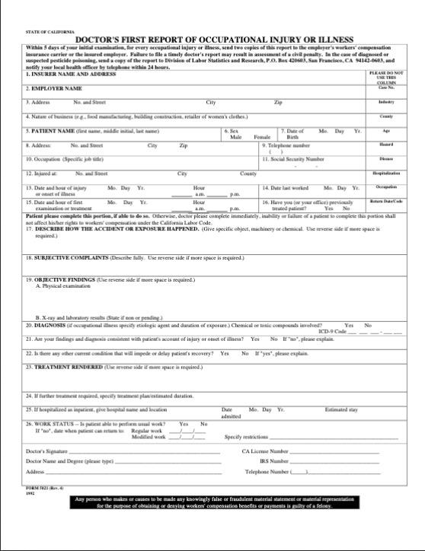
Step 4. Securely Deliver Documents to RateFast
Gather the claim documents obtained in Step 1.
Include the cover page and authorization form.
Send documents to RateFast via fax or email.

Slide 13
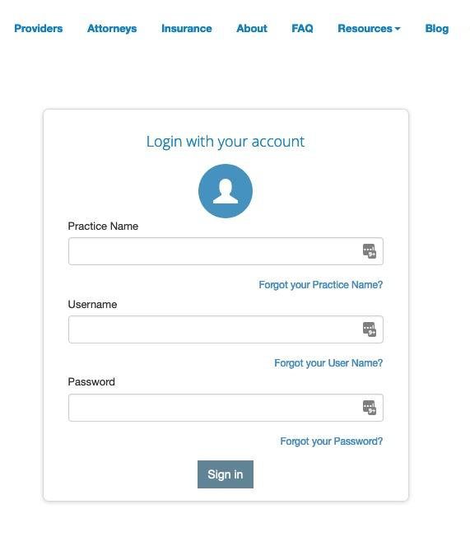
Step 5. Download The Completed PR-4 Report
In 3 to 5 business days, you will receive an email notification that the impairment report is complete.
Login to RateFast.
Download the report.
Send to the physician for review and signature.

Slide 14
Support
Monday to Friday, 8am to 6pm (Pacific Time)
Chris Hall - Product Support
(707) 484-5778 • c.hall@rate-fast.com
General Support
(707) 304-7150 • express@rate-fast.com
Resource Page
www.genexratefast.com

Slide 15
Questions?

